Slide 1

Module 6 – Video 1
Simple Vs. Complex Pricing – Introduction
Professor Nico Voigtländer
Management 405: Module 6

Slide 2
OUTLINE of module 6
Simple vs. complex pricing
Direct price discrimination
  Perfect price discrimination (first degree)
  Segment pricing (third degree)
Indirect price discrimination (second degree)
  Versioning
  Coupons
Advanced pricing strategies
  Volume pricing with flat fee
  Two-part tariff
  Block pricing

Slide 3
OUTLINE of module 6
Simple vs. complex pricing
Direct price discrimination
  Perfect price discrimination (first degree)
  Segment pricing (third degree)
Indirect price discrimination (second degree)
  Versioning
  Coupons
Advanced pricing strategies
  Volume pricing with flat fee
  Two-part tariff
  Block pricing

Slide 4
Dilemma of simple pricing
Simple pricing: same price for all customers
Limitations of simple pricing:
  If you charge a high price, you prevent customers with relatively low willingness to pay (marginal personal value) from purchasing your product
  If you charge a low price, you are too “generous” to those with high willingness to pay

Slide 5
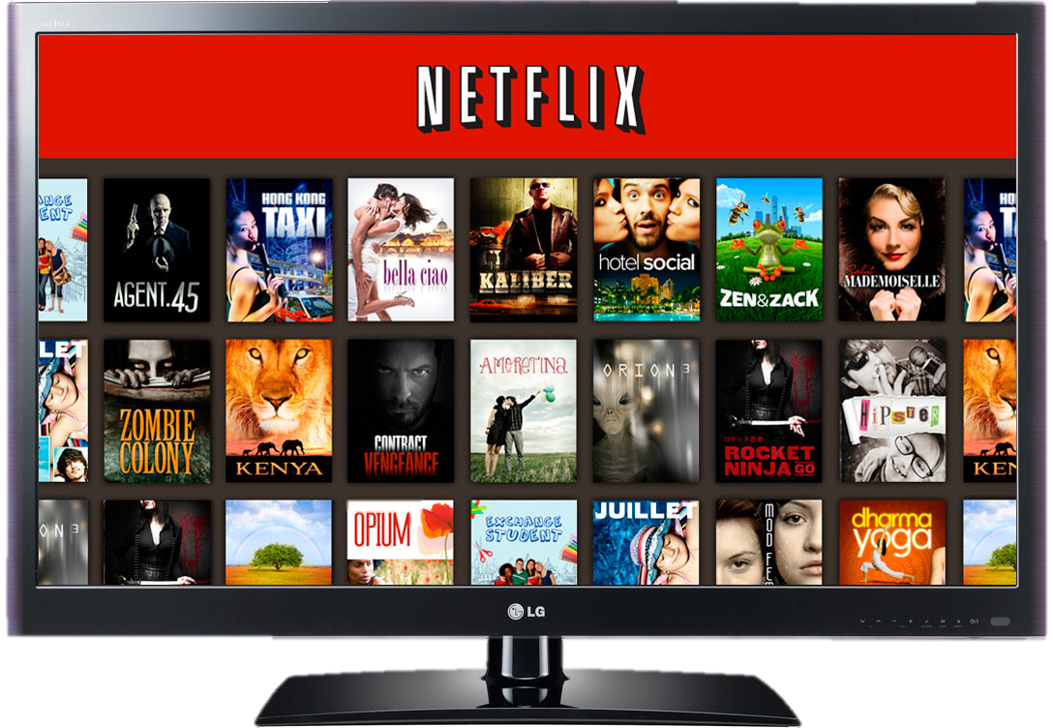
What if Netflix used Simple pricing per movie? (assume MC=0)
P
$2
P=2-Q/8
Since MC = 0, profit max.
implies: MR=MC=0
Under simple pricing, Netflix
would charge $1 per movie
$1
Max. TR
=$8
D
MC=0
8
16
Movies
MR
Notes:
When an individual can buy several units of an item, the seller can think about a volume pricing strategy. This is the case of continuous choice as opposed to binary choice (buy/don’t buy). Diminishing marginal personal value comes into play – the value of each subsequent unit falls.
We will talk about 3 kinds of volume pricing; we will see examples of each - they all amount to the same thing:
— Fixed fee + access price
— All or nothing pricing: bundle.
— Quantity discounts: sliding scale.
Examples of volume pricing:
— Rockreation: fixed monthly fee, unlimited access. Also, price differences with SLC. Is it price discrimination (probably, no – may reflect cost differentials, especially rent)
— Health Club: Annual fee
— Car Wash: Fixed fee - unlimited washes
— Netflix: Monthly fee – “unlimited” rentals
Analytics will help to clarify all this here. We still abstract from cost and set MC=0. The optimal price is where Q=10 because the slope of MR is twice the slope of D and we are setting MR=0. Under simple pricing, there is unexploited volume equal to the lower triangle ($100 of value) and the consumer retains a surplus of $100. The company ends up with revenues of $200. There is some opportunity to do some business here.

Slide 6
Simple pricing:
Netflix would ‘lose’ Revenues
P
P=2-Q/8
Simplifying assumption: MC=0
“Wasted profits”: consumer surplus + unexploited markets
Can do better using complex pricing
Consumer Surplus
Revenues
$2
Unexploited Markets
8
16
Q
Notes:
Ask in class if this is a price searcher or price taker
The dilemma of pricing is that if you charge a high price to capture a lot of value, you exclude many from wanting to buy the product, namely the hordes of those with valuations for the product that are lower than price. The alternative is to go with volume, but then you have to charge a low price and you give away a lot of consumer surplus, leave a lot of surplus on the table which you do not capture. There is a dilemma. Today we will see how to escape the dilemma through price discrimination.

Slide 7
Complex (non-uniform) pricing
Requirements for complex pricing:
Market power
  Downward-sloping demand (i.e., price searcher)
    So far, we studied simple pricing of price searchers
    Now: Complex pricing
Capacity to prevent resale and arbitrage
  Enables sellers to charge different prices for different volumes/packages, or to different customers
Complex pricing is usually more profitable than simple pricing.
Notes:
Consumers are better off under resale: low-price consumers can resell their purchases at a profit; high-price consumers can buy product at a lower price than the firm would charge
Firms are not better off, since only selling at one price, the lower price!

Slide 8
Three degrees of price discrimination
First degree:
  “Dream world”: firm knows each customer’s willingness to pay (marginal personal value – MPV)
Third degree:
  Firm can identify specific groups of customers with different MPV (students, seniors, tourists)
Second degree (“indirect”):
  Firm cannot directly identify the different customers’ MPV. Instead, the firm uses different purchase options to infer willingness to pay: versioning, quantity discounts, coupons

